Slide 1
Open Questions in Radiation Belt Research

Slide 2
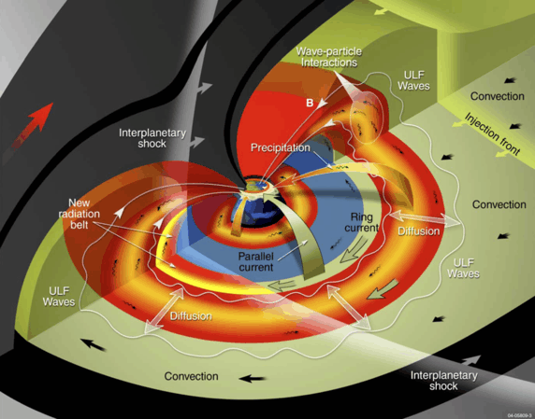
Major gaps in our understanding of radiation belt phenomena
The relative contribution between radial transport/diffusion and local wave acceleration to radiation belt enhancements is still not well-quantified
What is the role of wave-particle interactions (e.g., due to EMIC waves) in rapid, large-scale radiation belt dropouts, relative to magnetopause shadowing?
How does energetic particle precipitation (EPP) from the radiation belt/ring current impact the ionosphere, and upper atmospheric chemistry and climate?
What role do interplanetary shocks play in transporting radiation belt electrons to low L? Why have we not observed >1.5 MeV electrons in the inner zone during the Van Allen Probes era?
What role do nonlinear interactions and other effects play in the global state of the radiation belt? What is the relative role of quasilinear vs nonlinear interactions?
Mauk+ [2013]

Slide 3
Major gaps in our understanding of radiation belt phenomena
The relative contribution between radial transport/diffusion and local wave acceleration to radiation belt enhancements is still not well-quantified
What is the role of wave-particle interactions (e.g., due to EMIC waves) in rapid, large-scale radiation belt dropouts, relative to magnetopause shadowing?
How does energetic particle precipitation (EPP) from the radiation belt/ring current impact the ionosphere, and upper atmospheric chemistry and climate?
What role do interplanetary shocks play in transporting radiation belt electrons to low L? Why have we not observed >1.5 MeV electrons in the inner zone during the Van Allen Probes era?
What role do nonlinear interactions and other effects play in the global state of the radiation belt? What is the relative role of quasilinear vs nonlinear interactions?
Mauk+ [2013]

Slide 4
Major gaps in our understanding of radiation belt phenomena
The relative contribution between radial transport/diffusion and local wave acceleration to radiation belt enhancements is still not well-quantified
What is the role of wave-particle interactions (e.g., due to EMIC waves) in rapid, large-scale radiation belt dropouts, relative to magnetopause shadowing?
How does energetic particle precipitation (EPP) from the radiation belt/ring current impact the ionosphere, and upper atmospheric chemistry and climate?
What role do interplanetary shocks play in transporting radiation belt electrons to low L? Why have we not observed >1.5 MeV electrons in the inner zone during the Van Allen Probes era?
What role do nonlinear interactions and other effects play in the global state of the radiation belt? What is the relative role of quasilinear vs nonlinear interactions?
Mauk+ [2013]

Slide 5
Major gaps in our understanding of radiation belt phenomena
The relative contribution between radial transport/diffusion and local wave acceleration to radiation belt enhancements is still not well-quantified
What is the role of wave-particle interactions (e.g., due to EMIC waves) in rapid, large-scale radiation belt dropouts, relative to magnetopause shadowing?
How does energetic particle precipitation (EPP) from the radiation belt/ring current impact the ionosphere, and upper atmospheric chemistry and climate?
What role do interplanetary shocks play in transporting radiation belt electrons to low L? Why have we not observed >1.5 MeV electrons in the inner zone during the Van Allen Probes era?
What role do nonlinear interactions and other effects play in the global state of the radiation belt? What is the relative role of quasilinear vs nonlinear interactions?
Mauk+ [2013]

Slide 6
Major gaps in our understanding of radiation belt phenomena
The relative contribution between radial transport/diffusion and local wave acceleration to radiation belt enhancements is still not well-quantified
What is the role of wave-particle interactions (e.g., due to EMIC waves) in rapid, large-scale radiation belt dropouts, relative to magnetopause shadowing?
How does energetic particle precipitation (EPP) from the radiation belt/ring current impact the ionosphere, and upper atmospheric chemistry and climate?
What role do interplanetary shocks play in transporting radiation belt electrons to low L? Why have we not observed >1.5 MeV electrons in the inner zone during the Van Allen Probes era?
What role do nonlinear interactions and other effects play in the global state of the radiation belt? What is the relative role of quasilinear vs nonlinear interactions?
Mauk+ [2013]

Slide 7
Major gaps in our understanding of radiation belt phenomena
The relative contribution between radial transport/diffusion and local wave acceleration to radiation belt enhancements is still not well-quantified
What is the role of wave-particle interactions (e.g., due to EMIC waves) in rapid, large-scale radiation belt dropouts, relative to magnetopause shadowing?
How does energetic particle precipitation (EPP) from the radiation belt/ring current impact the ionosphere, and upper atmospheric chemistry and climate?
What role do interplanetary shocks play in transporting radiation belt electrons to low L? Why have we not observed >1.5 MeV electrons in the inner zone during the Van Allen Probes era?
What role do nonlinear interactions and other effects play in the global state of the radiation belt? What is the relative role of quasilinear vs nonlinear interactions?
Mauk+ [2013]

Slide 8
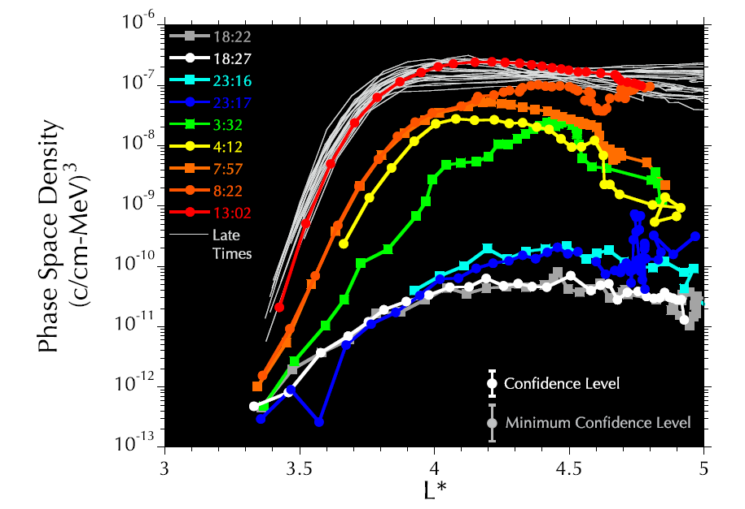
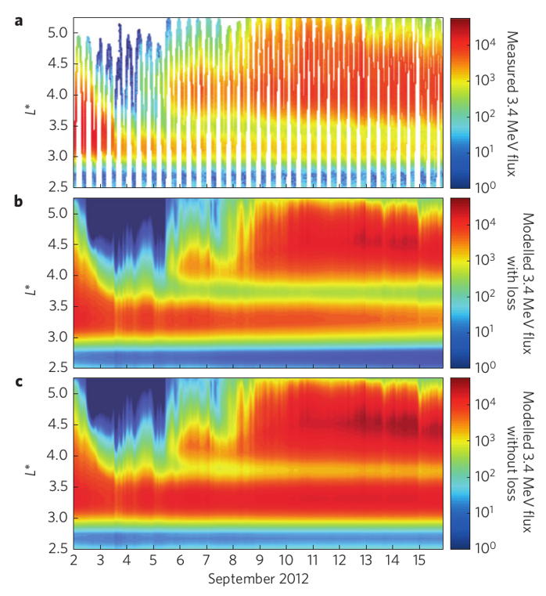
Major Gap 1 Radial transport/diffusion vs local wave acceleration in enhancements
In enhancements, what is the relative importance of local acceleration (e.g., via chorus waves) vs radial transport (e.g., via ULF waves)?
The verdict is still out and the community remains sharply divided
Some favor ULF-enhanced radial transport (only)
Some favor local heating via chorus waves (only)
Some favor an interplay between the two, with the relative importance different in each case
There is no doubt a growing peak in phase space density is observed in some/many instances, which requires local acceleration
But often radial transport appears to dominate the overall change in magnitude in many cases
There are also a number of questions related to PSD peaks that must be clarified
Reeves+ [2013]
Mann+ [2016]

Slide 9
Major Gap 1 Radial transport/diffusion vs local wave acceleration in enhancements
In enhancements, what is the relative importance of local acceleration (e.g., via chorus waves) vs radial transport (e.g., via ULF waves)?
The verdict is still out and the community remains sharply divided
Some favor ULF-enhanced radial transport (only)
Some favor local heating via chorus waves (only)
Some favor an interplay between the two, with the relative importance different in each case
There is no doubt a growing peak in phase space density is observed in some/many instances, which requires local acceleration
But often radial transport appears to dominate the overall change in magnitude in many cases
There are also a number of questions related to PSD peaks that must be clarified
Reeves+ [2013]
Mann+ [2016]

Slide 10
Major Gap 1 Radial transport/diffusion vs local wave acceleration in enhancements
In enhancements, what is the relative importance of local acceleration (e.g., via chorus waves) vs radial transport (e.g., via ULF waves)?
The verdict is still out and the community remains sharply divided
Some favor ULF-enhanced radial transport (only)
Some favor local heating via chorus waves (only)
Some favor an interplay between the two, with the relative importance different in each case
There is no doubt a growing peak in phase space density is observed in some/many instances, which requires local acceleration
But often radial transport appears to dominate the overall change in magnitude in many cases
There are also a number of questions related to PSD peaks that must be clarified
Reeves+ [2013]
Li Z.+ [2017]
Mann+ [2016]

Slide 11
Major Gap 1 Radial transport/diffusion vs local wave acceleration in enhancements
In enhancements, what is the relative importance of local acceleration (e.g., via chorus waves) vs radial transport (e.g., via ULF waves)?
The verdict is still out and the community remains sharply divided
Some favor ULF-enhanced radial transport (only)
Some favor local heating via chorus waves (only)
Some favor an interplay between the two, with the relative importance different in each case
There is no doubt a growing peak in phase space density is observed in some/many instances, which requires local acceleration
But often radial transport appears to dominate the overall change in magnitude in many cases
There are also a number of questions related to PSD peaks that must be clarified
Reeves+ [2013]
Li Z.+ [2017]
Mann+ [2016]

Slide 12
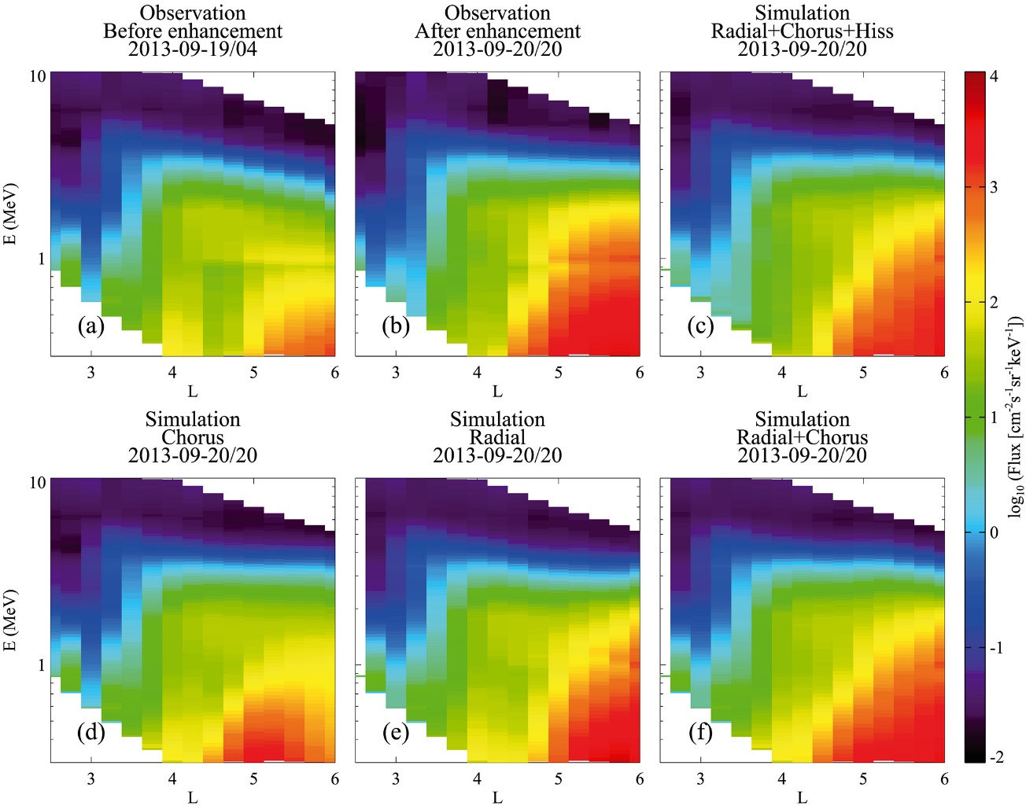
Major Gap 1 Radial transport/diffusion vs local wave acceleration in enhancements
How do we disentangle the relative roles of chorus and ULF in enhancements?
Observations
Conduct more synthesis modeling that properly accounts for the effects of both chorus and ULF
Conduct more multipoint studies to develop a better understanding of the spatial extents of different waves during individual events.
What range of activity levels and extents do different wave modes show from event to event?
Can ULF and chorus effects be separated in observations?
Do they always occur together?
How is the usual proxy of chorus waves influenced by ULF wave activity (e.g., Dimitrakoudis and Mann, [2019])?
What is the role of seed/source electrons from substorm injections and enhanced convection in the formation and variability of the outer belt?
What fraction of these electrons are convected inward vs locally accelerated? Inductive electric fields? Some other mechanism?
Are seed and source electrons injected simultaneously?
Pre-Storm
Post-Storm
ULF+chorus+hiss
chorus (only)
ULF (only)
ULF+chorus
Ma+ [2018]

Slide 13
Major Gap 1 Radial transport/diffusion vs local wave acceleration in enhancements
How do we disentangle the relative roles of chorus and ULF in enhancements?
Observations
Conduct more synthesis modeling that properly accounts for the effects of both chorus and ULF
Conduct more multipoint studies to develop a better understanding of the spatial extents of different waves during individual events.
What range of activity levels and extents do different wave modes show from event to event?
Can ULF and chorus effects be separated in observations?
Do they always occur together?
How is the usual proxy of chorus waves influenced by ULF wave activity (e.g., Dimitrakoudis and Mann, [2019])?
What is the role of seed/source electrons from substorm injections and enhanced convection in the formation and variability of the outer belt?
What fraction of these electrons are convected inward vs locally accelerated? Inductive electric fields? Some other mechanism?
Are seed and source electrons injected simultaneously?
Pre-Storm
Post-Storm
ULF+chorus+hiss
chorus (only)
ULF (only)
ULF+chorus
Ma+ [2018]

Slide 14
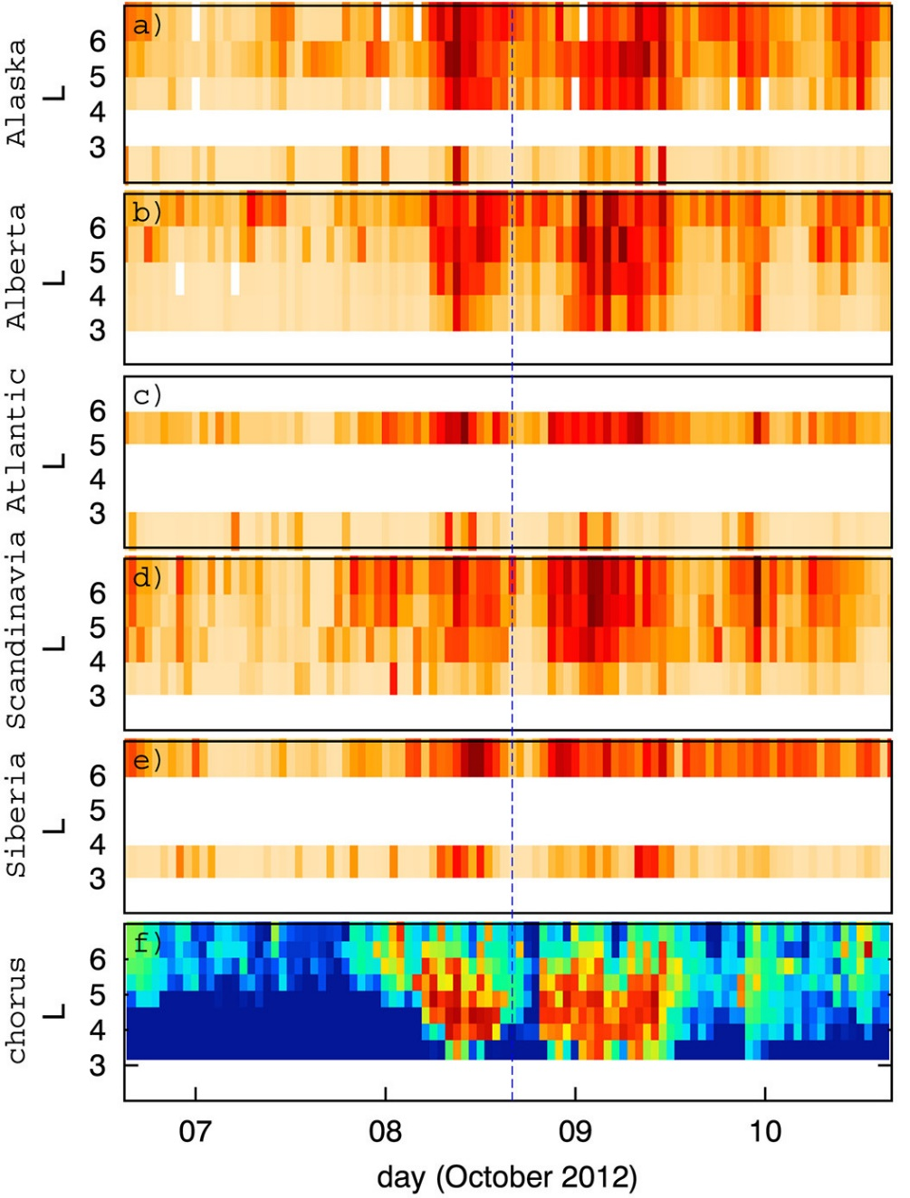
Major Gap 1 Radial transport/diffusion vs local wave acceleration in enhancements
How do we disentangle the relative roles of chorus and ULF in enhancements?
Conduct more synthesis modeling that properly accounts for the effects of both chorus and ULF
Conduct more multipoint studies to develop a better understanding of the spatial extents of different waves during individual events.
What range of activity levels and extents do different wave modes show from event to event?
Can ULF and chorus effects be separated in observations?
Do they always occur together?
How is the usual proxy of chorus waves influenced by ULF wave activity (e.g., Dimitrakoudis and Mann, [2019])?
What is the role of seed/source electrons from substorm injections and enhanced convection in the formation and variability of the outer belt?
What fraction of these electrons are convected inward vs locally accelerated? Inductive electric fields? Some other mechanism?
Are seed and source electrons injected simultaneously?
Dimitrakoudis+Mann [2019]

Slide 15
Major Gap 1 Radial transport/diffusion vs local wave acceleration in enhancements
How do we disentangle the relative roles of chorus and ULF in enhancements?
Conduct more synthesis modeling that properly accounts for the effects of both chorus and ULF
Conduct more multipoint studies to develop a better understanding of the spatial extents of different waves during individual events.
What range of activity levels and extents do different wave modes show from event to event?
Can ULF and chorus effects be separated in observations?
Do they always occur together?
How is the usual proxy of chorus waves influenced by ULF wave activity (e.g., Dimitrakoudis and Mann, [2019])?
What is the role of seed/source electrons from substorm injections and enhanced convection in the formation and variability of the outer belt?
What fraction of these electrons are convected inward vs locally accelerated? Inductive electric fields? Some other mechanism?
Are seed and source electrons injected simultaneously?
southward IMF
substorm injections
(source: ~1 keV e⁻)
substorm injections
(seed: ~100 keV e⁻)
chorus waves
MeV electrons
After Jaynes+ [2015]

Slide 16
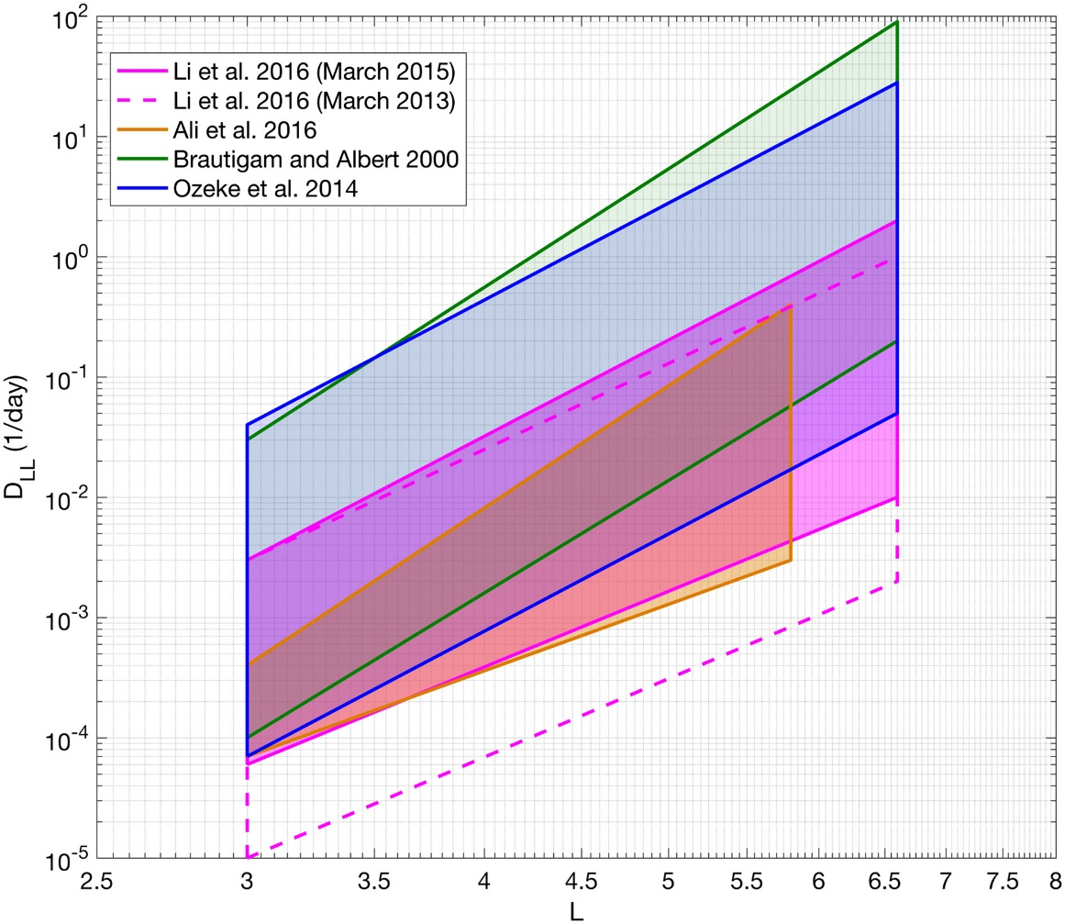
Major Gap 1 Radial transport/diffusion vs local wave acceleration in enhancements
Questions surrounding radial diffusion coefficients
Crucial to have accurate/improved radial diffusion coefficients
Can be applied to various PSD gradient scenarios to clarify the role of ULF waves in acceleration/transport (and loss)
Are we computing D_{LL} correctly?
Are the techniques that we use to measure D_{LL} from a single satellite and/or ground measurements valid?
Is the m = 1 assumption valid?
Are our theoretical formulations/implementations even correct? (Lejosne [2019])
Can/should statistical D_{LL} be used for event modeling?
Event-specific D_{LL} is often very different (e.g., Olifer+ [2019])

Slide 17
Major Gap 1 Radial transport/diffusion vs local wave acceleration in enhancements
Questions surrounding radial diffusion coefficients
Crucial to have accurate/improved radial diffusion coefficients
Can be applied to various PSD gradient scenarios to clarify the role of ULF waves in acceleration/transport (and loss)
Are we computing D_{LL} correctly?
Are the techniques that we use to measure D_{LL} from a single satellite and/or ground measurements valid?
Is the m = 1 assumption valid?
Are our theoretical formulations/implementations even correct? (Lejosne [2019])
Can/should statistical D_{LL} be used for event modeling?
Event-specific D_{LL} is often very different (e.g., Olifer+ [2019])

Slide 18
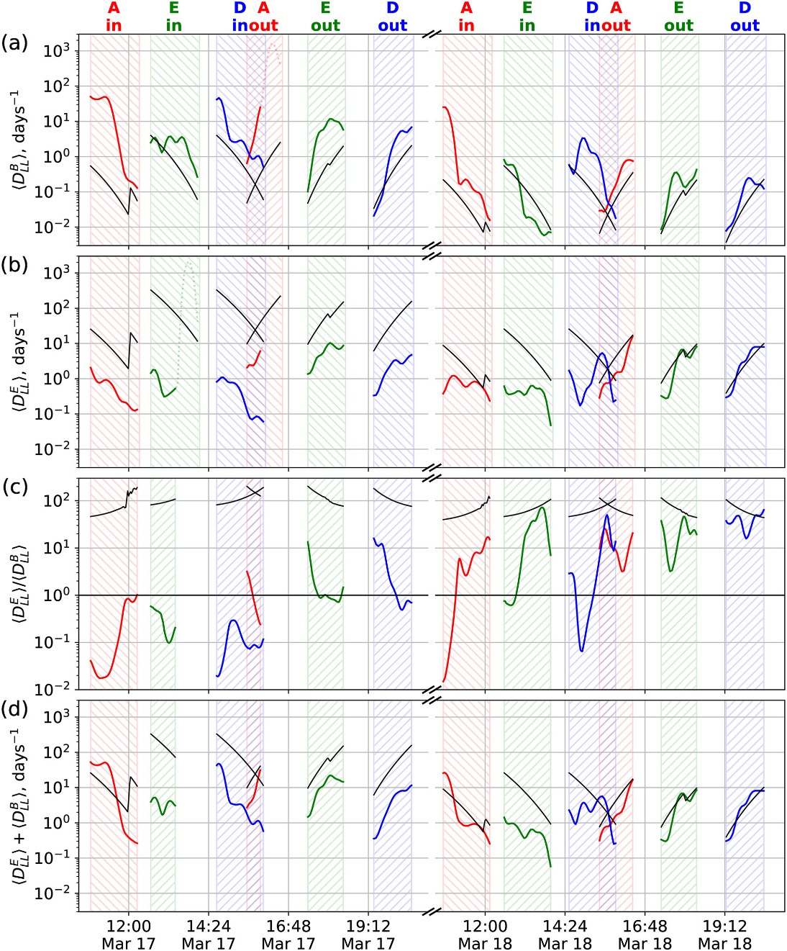
Major Gap 1 Radial transport/diffusion vs local wave acceleration in enhancements
Questions surrounding radial diffusion coefficients
Crucial to have accurate/improved radial diffusion coefficients
Can be applied to various PSD gradient scenarios to clarify the role of ULF waves in acceleration/transport (and loss)
Are we computing D_{LL} correctly?
Are the techniques that we use to measure D_{LL} from a single satellite and/or ground measurements valid?
Is the m = 1 assumption valid?
Are our theoretical formulations/implementations even correct? (Lejosne [2019])
Can/should statistical D_{LL} be used for event modeling?
Event-specific D_{LL} is often very different (e.g., Olifer+ [2019])
Olifer+ [2019]

Slide 19
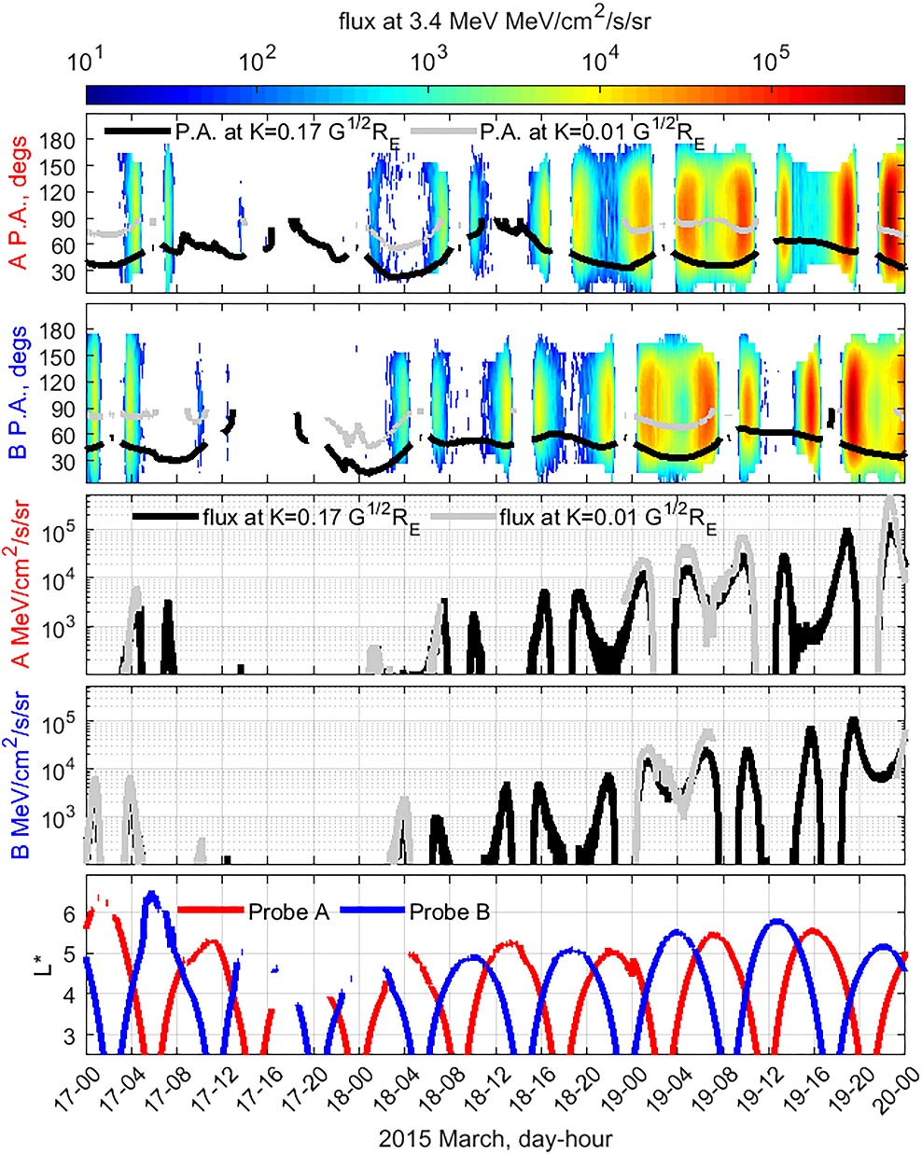
Major Gap 1 Radial transport/diffusion vs local wave acceleration in enhancements
Questions surrounding phase space density peaks
Are the PSD peaks observed in the bulk of the distribution?
Other measurements to help determine the radial location of the peak?
Intercalibration issues? Global magnetic field models?
These are not well understood, nor widely discussed
How much radiation belt variability is simply caused by distortions of the geomagnetic field?
Ozeke+ [2019]

Slide 20
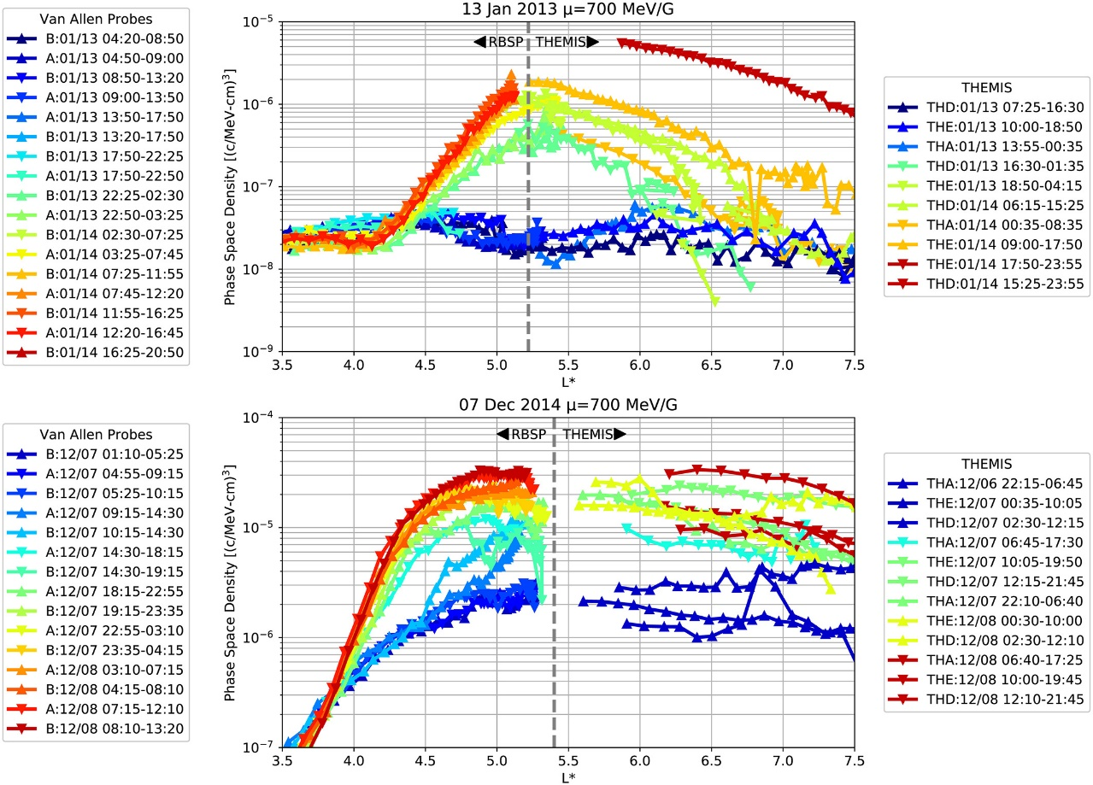
Major Gap 1 Radial transport/diffusion vs local wave acceleration in enhancements
Questions surrounding phase space density peaks
Are the PSD peaks observed in the bulk of the distribution?
Other measurements to help determine the radial location of the peak?
Intercalibration issues? Global magnetic field models?
These are not well understood, nor widely discussed
How much radiation belt variability is simply caused by distortions of the geomagnetic field?

Slide 21
Major Gap 1 Radial transport/diffusion vs local wave acceleration in enhancements
Questions surrounding phase space density peaks
Are the PSD peaks observed in the bulk of the distribution?
Other measurements to help determine the radial location of the peak?
Intercalibration issues? Global magnetic field models?
These are not well understood, nor widely discussed
How much radiation belt variability is simply caused by distortions of the geomagnetic field?

Slide 22
Major Gap 1 Radial transport/diffusion vs local wave acceleration in enhancements
Questions surrounding phase space density peaks
Are the PSD peaks observed in the bulk of the distribution?
Other measurements to help determine the radial location of the peak?
Intercalibration issues? Global magnetic field models?
These are not well understood, nor widely discussed
How much radiation belt variability is simply caused by distortions of the geomagnetic field?

Slide 23
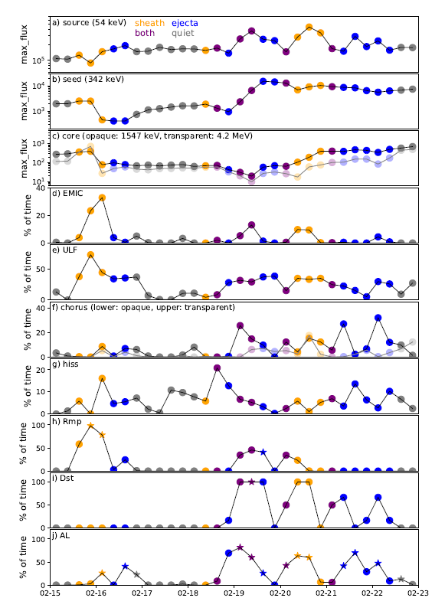
Major Gap 1 Radial transport/diffusion vs local wave acceleration in enhancements
New and different approaches to solving this problem?
Examine the acceleration problem from different perspectives/approaches, not just superposed epoch studies on Dst and/or solar wind parameters
Can we solve the ULF/chorus debate without using PSD?
Look more closely at different solar wind structures and how they the drive the wave modes that impact the radiation belts (e.g., Kilpua+ [2015,2019]; Turner+ [2019])
54 keV
flux
342 keV
1-4 MeV
EMIC
ULF
chorus
hiss
magnetopause
Dst
AL
Kilpua+ [2019]

Slide 24
Major gaps in our understanding of radiation belt phenomena
The relative contribution between radial transport/diffusion and local wave acceleration to radiation belt enhancements is still not well-quantified
What is the role of wave-particle interactions (e.g., due to EMIC waves) in rapid, large-scale radiation belt dropouts, relative to magnetopause shadowing?
How does energetic particle precipitation (EPP) from the radiation belt/ring current impact the ionosphere, and upper atmospheric chemistry and climate?
What role do interplanetary shocks play in transporting radiation belt electrons to low L? Why have we not observed >1.5 MeV electrons in the inner zone during the Van Allen Probes era?
What role do nonlinear interactions and other effects play in the global state of the radiation belt? What is the relative role of quasilinear vs nonlinear interactions?
Mauk+ [2013]

Slide 25
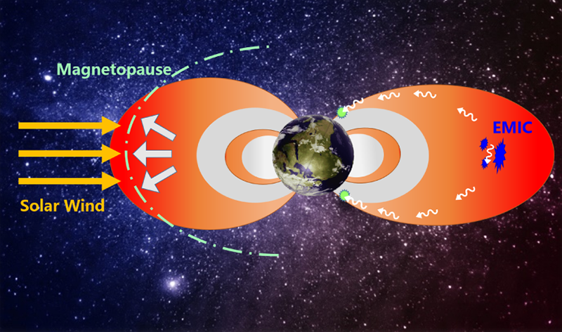
Major Gap 2 Precipitation (e.g., via EMIC waves) vs magnetopause shadowing in dropouts
From a qualitative perspective, we have a good handle on the various loss processes and how they work. However, there is a lot of work to do on quantitative loss calculations
How do dropouts occur so quickly and completely, even during smaller storm events?
Is it all MP shadowing and subsequent outward diffusion (Olifer+ [2018]; Mann+ [2016])?
Is it a combination with EMIC-driven (or other wave) precipitation (Usanova+ [2014])?
Xiang+ [2017]; AGU/EOS

Slide 26
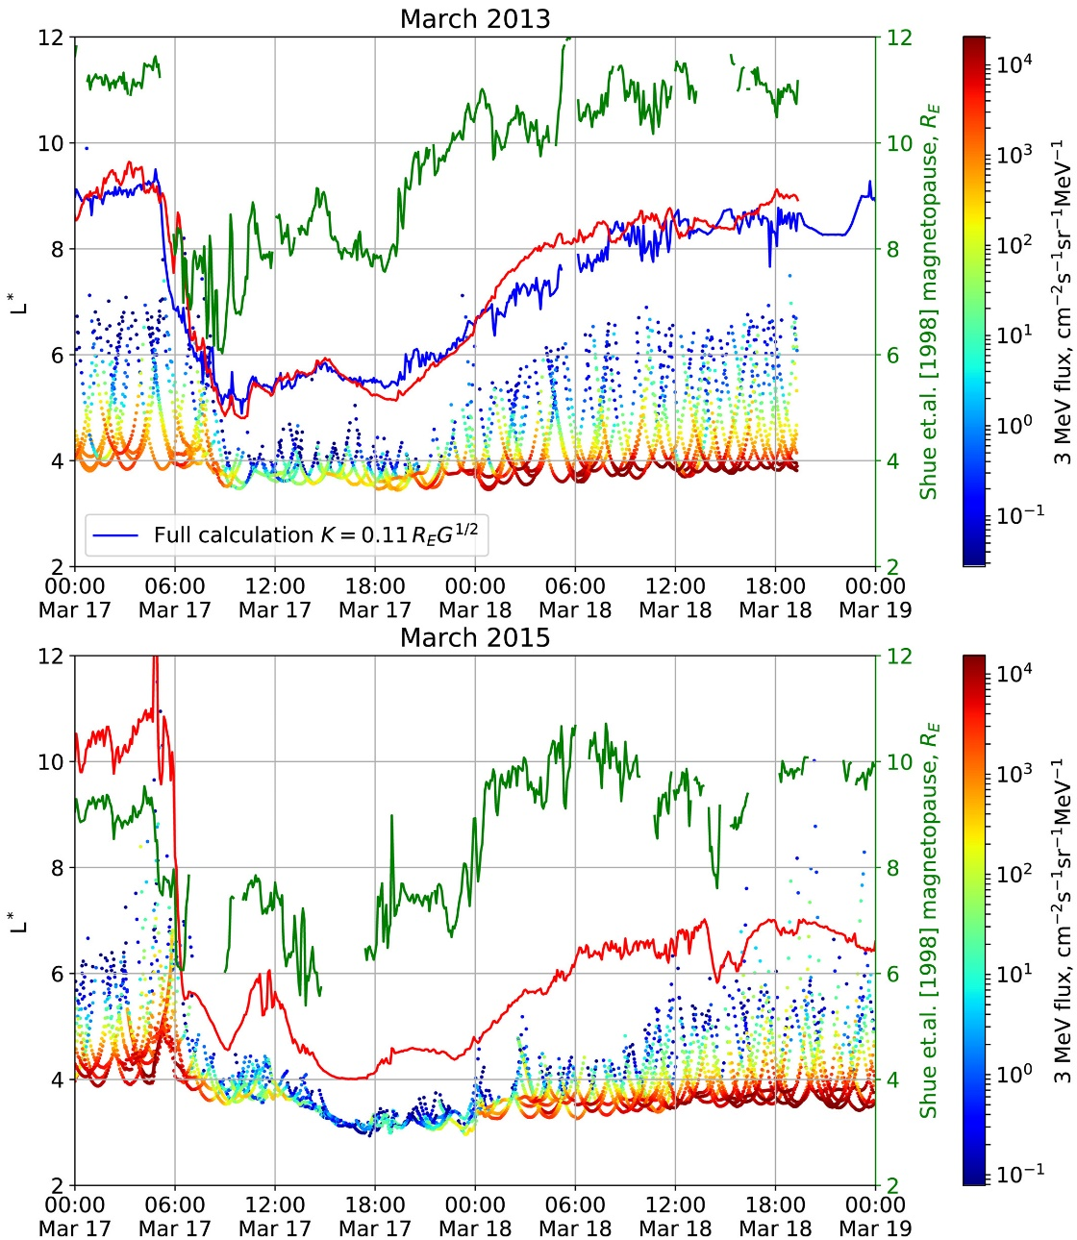
Major Gap 2 Precipitation (e.g., via EMIC waves) vs magnetopause shadowing in dropouts
From a qualitative perspective, we have a good handle on the various loss processes and how they work. However, there is a lot of work to do on quantitative loss calculations
How do dropouts occur so quickly and completely, even during smaller storm events?
Is it all MP shadowing and subsequent outward diffusion (Olifer+ [2018]; Mann+ [2016])?
Is it a combination with EMIC-driven (or other wave) precipitation (Usanova+ [2014])?
Olifer+ [2018]

Slide 27
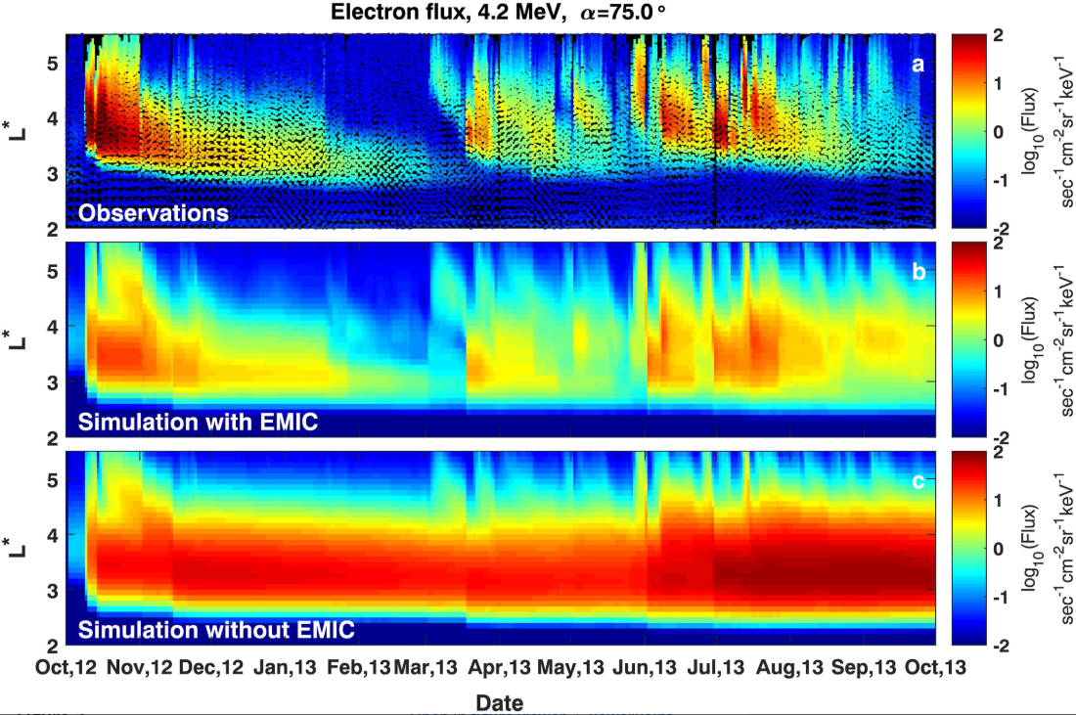
Major Gap 2 Precipitation (e.g., via EMIC waves) vs magnetopause shadowing in dropouts
Many questions surrounding EMIC waves
The MLT extent of EMIC waves is not well known is except in a statistical sense.
Are EMIC waves are very localized? Why are EMIC waves so bursty? Is quasilinear scattering appropriate?
Recent work has argued that EMIC waves can precipitate lower-energy/higher pitch angle electrons, contrary to standard theory (e.g. Denton+ [2015])
It is still unclear how EMIC waves can create local minima in PSD if the core population (near 90 degrees pitch angle) is unaffected by the interaction
How are EMIC waves generated at low L (1.5-2.5)? Do they contribute to scattering at these low L values?
Min+ [2012]
Drozdov+ [2017]

Slide 28
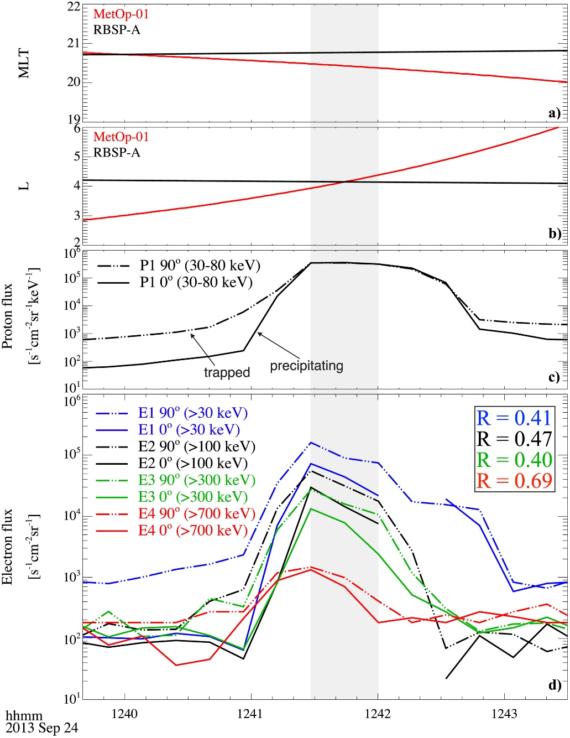
Major Gap 2 Precipitation (e.g., via EMIC waves) vs magnetopause shadowing in dropouts
Many questions surrounding EMIC waves
The MLT extent of EMIC waves is not well known is except in a statistical sense.
Are EMIC waves are very localized? Why are EMIC waves so bursty? Is quasilinear scattering appropriate?
Recent work has argued that EMIC waves can precipitate lower-energy/higher pitch angle electrons, contrary to standard theory (e.g. Denton+ [2015])
It is still unclear how EMIC waves can create local minima in PSD if the core population (near 90 degrees pitch angle) is unaffected by the interaction
How are EMIC waves generated at low L (1.5-2.5)? Do they contribute to scattering at these low L values?
Capannolo+ [2018]

Slide 29
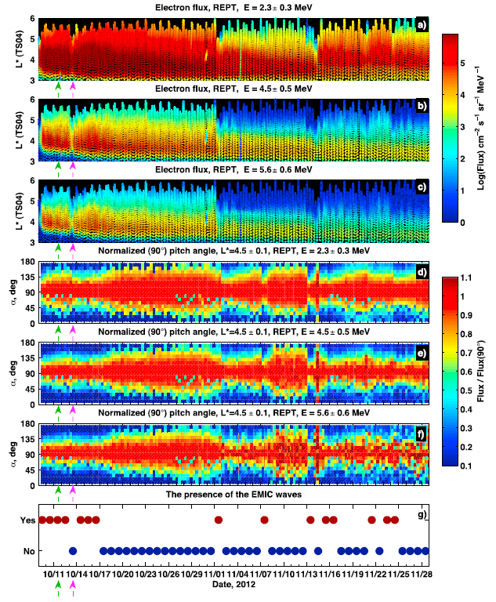
Major Gap 2 Precipitation (e.g., via EMIC waves) vs magnetopause shadowing in dropouts
Many questions surrounding EMIC waves
The MLT extent of EMIC waves is not well known is except in a statistical sense.
Are EMIC waves are very localized? Why are EMIC waves so bursty? Is quasilinear scattering appropriate?
Recent work has argued that EMIC waves can precipitate lower-energy/higher pitch angle electrons, contrary to standard theory (e.g. Denton+ [2015])
It is still unclear how EMIC waves can create local minima in PSD if the core population (near 90 degrees pitch angle) is unaffected by the interaction
How are EMIC waves generated at low L (1.5-2.5)? Do they contribute to scattering at these low L values?
Usanova+ [2014]

Slide 30
Major Gap 2 Precipitation (e.g., via EMIC waves) vs magnetopause shadowing in dropouts
Many questions surrounding EMIC waves
The MLT extent of EMIC waves is not well known is except in a statistical sense.
Are EMIC waves are very localized? Why are EMIC waves so bursty? Is quasilinear scattering appropriate?
Recent work has argued that EMIC waves can precipitate lower-energy/higher pitch angle electrons, contrary to standard theory (e.g. Denton+ [2015])
It is still unclear how EMIC waves can create local minima in PSD if the core population (near 90 degrees pitch angle) is unaffected by the interaction
How are EMIC waves generated at low L (1.5-2.5)? Do they contribute to scattering at these low L values?
Min+ [2012]
Drozdov+ [2017]

Slide 31
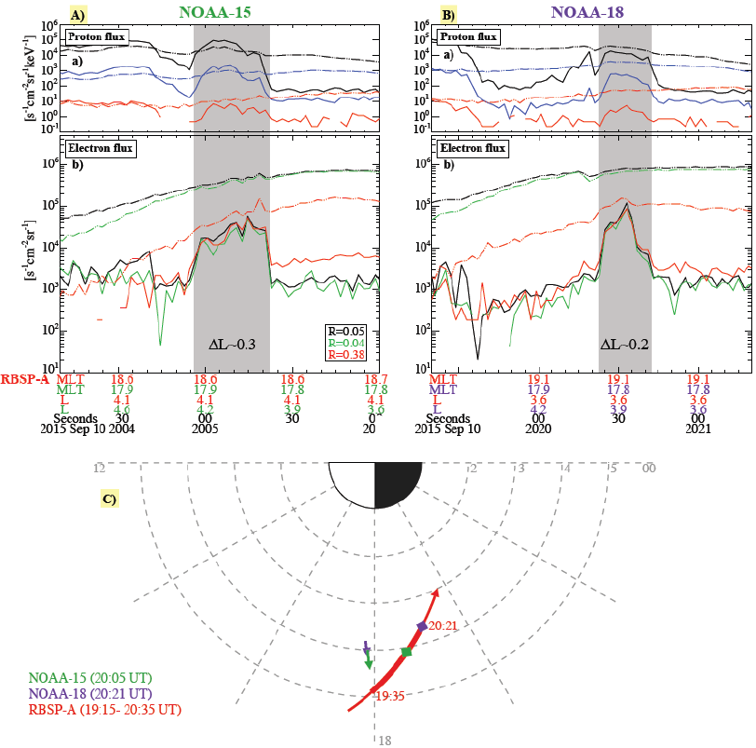
Major Gap 2 Precipitation (e.g., via EMIC waves) vs magnetopause shadowing in dropouts
Precipitation patterns at low altitude vs wave properties observed at high altitude?
What is the relationship between precipitation patches observed at low altitude and plasma wave populations in space?
What waves produce precipitation and when/where? e.g. Sometimes precipitation is observed by several BARREL balloons along MLT, but not by one in between: why?
Better quantification of how chorus waves and keV/MeV microbursts contribute to global losses
How important are chorus waves for precipitating both 10-100s keV and MeV electrons?
We need improved estimates of the spatial and temporal coherence scales of magnetospheric waves
Crucial towards a quantitative understanding of precipitation/loss
Spatial and coherence scales vary between wave modes (Blum+ [2016]; Agapitov+ [2017, 2018]; Crew+ [2016]; Blake+ [2016])
Capannolo+ [2019]

Slide 32
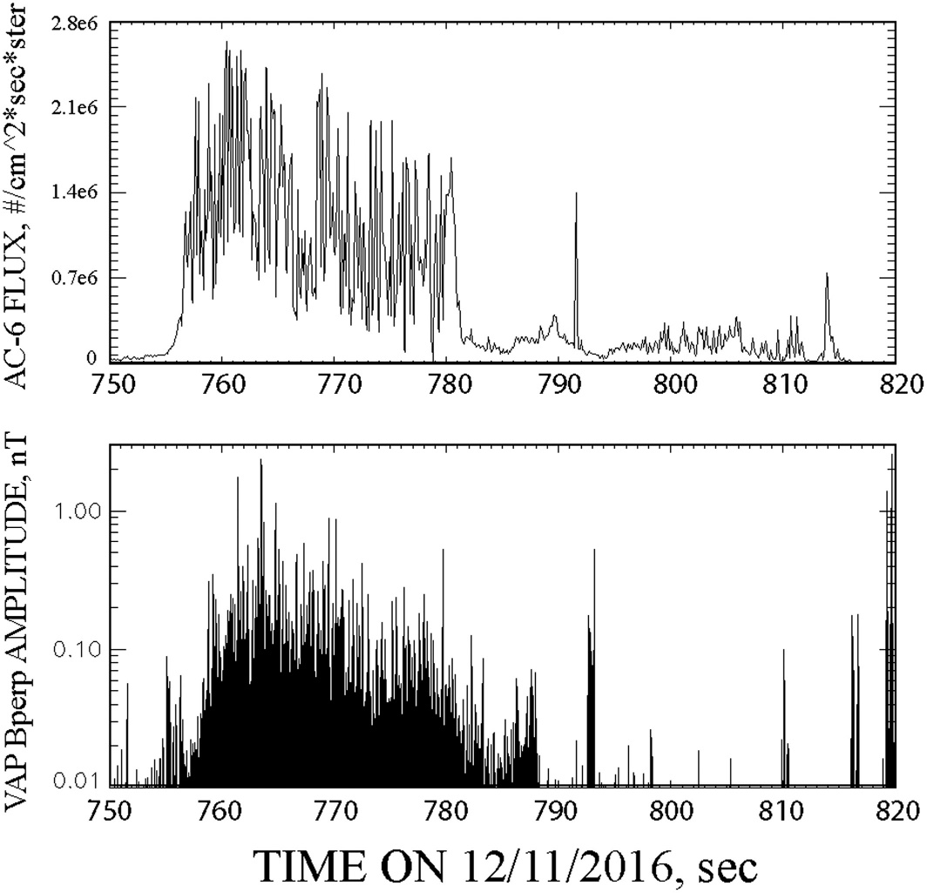
Major Gap 2 Precipitation (e.g., via EMIC waves) vs magnetopause shadowing in dropouts
Precipitation patterns at low altitude vs wave properties observed at high altitude?
What is the relationship between precipitation patches observed at low altitude and plasma wave populations in space?
What waves produce precipitation and when/where? e.g. Sometimes precipitation is observed by several BARREL balloons along MLT, but not by one in between: why?
Better quantification of how chorus waves and keV/MeV microbursts contribute to global losses
How important are chorus waves for precipitating both 10-100s keV and MeV electrons?
We need improved estimates of the spatial and temporal coherence scales of magnetospheric waves
Crucial towards a quantitative understanding of precipitation/loss
Spatial and coherence scales vary between wave modes (Blum+ [2016]; Agapitov+ [2017, 2018]; Crew+ [2016]; Blake+ [2016])
Mozer+ [2018]

Slide 33
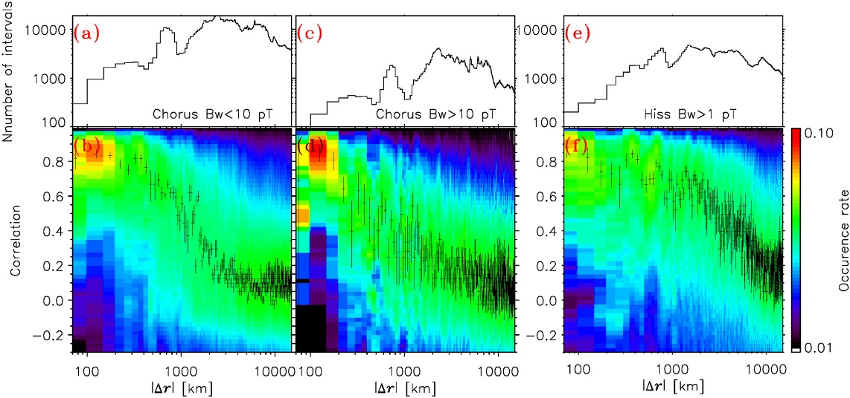
Major Gap 2 Precipitation (e.g., via EMIC waves) vs magnetopause shadowing in dropouts
Precipitation patterns at low altitude vs wave properties observed at high altitude?
What is the relationship between precipitation patches observed at low altitude and plasma wave populations in space?
What waves produce precipitation and when/where? e.g. Sometimes precipitation is observed by several BARREL balloons along MLT, but not by one in between: why?
Better quantification of how chorus waves and keV/MeV microbursts contribute to global losses
How important are chorus waves for precipitating both 10-100s keV and MeV electrons?
We need improved estimates of the spatial and temporal coherence scales of magnetospheric waves
Crucial towards a quantitative understanding of precipitation/loss
Spatial and coherence scales vary between wave modes (Blum+ [2016]; Agapitov+ [2017, 2018]; Crew+ [2016]; Blake+ [2016])
Agapitov+ [2018]

Slide 34
Major gaps in our understanding of radiation belt phenomena
The relative contribution between radial transport/diffusion and local wave acceleration to radiation belt enhancements is still not well-quantified
What is the role of wave-particle interactions (e.g., due to EMIC waves) in rapid, large-scale radiation belt dropouts, relative to magnetopause shadowing?
How does energetic particle precipitation (EPP) from the radiation belt/ring current impact the ionosphere, and upper atmospheric chemistry and climate?
What role do interplanetary shocks play in transporting radiation belt electrons to low L? Why have we not observed >1.5 MeV electrons in the inner zone during the Van Allen Probes era?
What role do nonlinear interactions and other effects play in the global state of the radiation belt? What is the relative role of quasilinear vs nonlinear interactions?
Mauk+ [2013]

Slide 35
Major gaps in our understanding of radiation belt phenomena
The relative contribution between radial transport/diffusion and local wave acceleration to radiation belt enhancements is still not well-quantified
What is the role of wave-particle interactions (e.g., due to EMIC waves) in rapid, large-scale radiation belt dropouts, relative to magnetopause shadowing?
How does energetic particle precipitation (EPP) from the radiation belt/ring current impact the ionosphere, and upper atmospheric chemistry and climate?
What role do interplanetary shocks play in transporting radiation belt electrons to low L? Why have we not observed >1.5 MeV electrons in the inner zone during the Van Allen Probes era?
What role do nonlinear interactions and other effects play in the global state of the radiation belt? What is the relative role of quasilinear vs nonlinear interactions?
Mauk+ [2013]

Slide 36
Major gaps in our understanding of radiation belt phenomena
The relative contribution between radial transport/diffusion and local wave acceleration to radiation belt enhancements is still not well-quantified
What is the role of wave-particle interactions (e.g., due to EMIC waves) in rapid, large-scale radiation belt dropouts, relative to magnetopause shadowing?
How does energetic particle precipitation (EPP) from the radiation belt/ring current impact the ionosphere, and upper atmospheric chemistry and climate?
What role do interplanetary shocks play in transporting radiation belt electrons to low L? Why have we not observed >1.5 MeV electrons in the inner zone during the Van Allen Probes era?
What role do nonlinear interactions and other effects play in the global state of the radiation belt? What is the relative role of quasilinear vs nonlinear interactions?
Mauk+ [2013]

Slide 37
Major gaps in our understanding of radiation belt phenomena
The relative contribution between radial transport/diffusion and local wave acceleration to radiation belt enhancements is still not well-quantified
What is the role of wave-particle interactions (e.g., due to EMIC waves) in rapid, large-scale radiation belt dropouts, relative to magnetopause shadowing?
How does energetic particle precipitation (EPP) from the radiation belt/ring current impact the ionosphere, and upper atmospheric chemistry and climate?
What role do interplanetary shocks play in transporting radiation belt electrons to low L? Why have we not observed >1.5 MeV electrons in the inner zone during the Van Allen Probes era?
What role do nonlinear interactions and other effects play in the global state of the radiation belt? What is the relative role of quasilinear vs nonlinear interactions?
Mauk+ [2013]

Slide 38
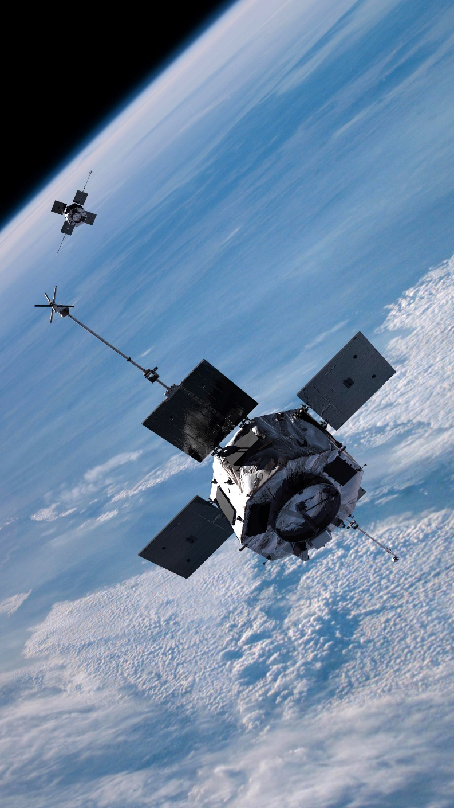
Looking ahead
Improve our radiation belt modeling capabilities
Improve our understanding of extreme radiation belt environments
Exploit data from current and upcoming missions to answer outstanding questions
Propose new missions and instrumentation to answer outstanding questions
Credit: NASA/JHU/APL

Slide 39
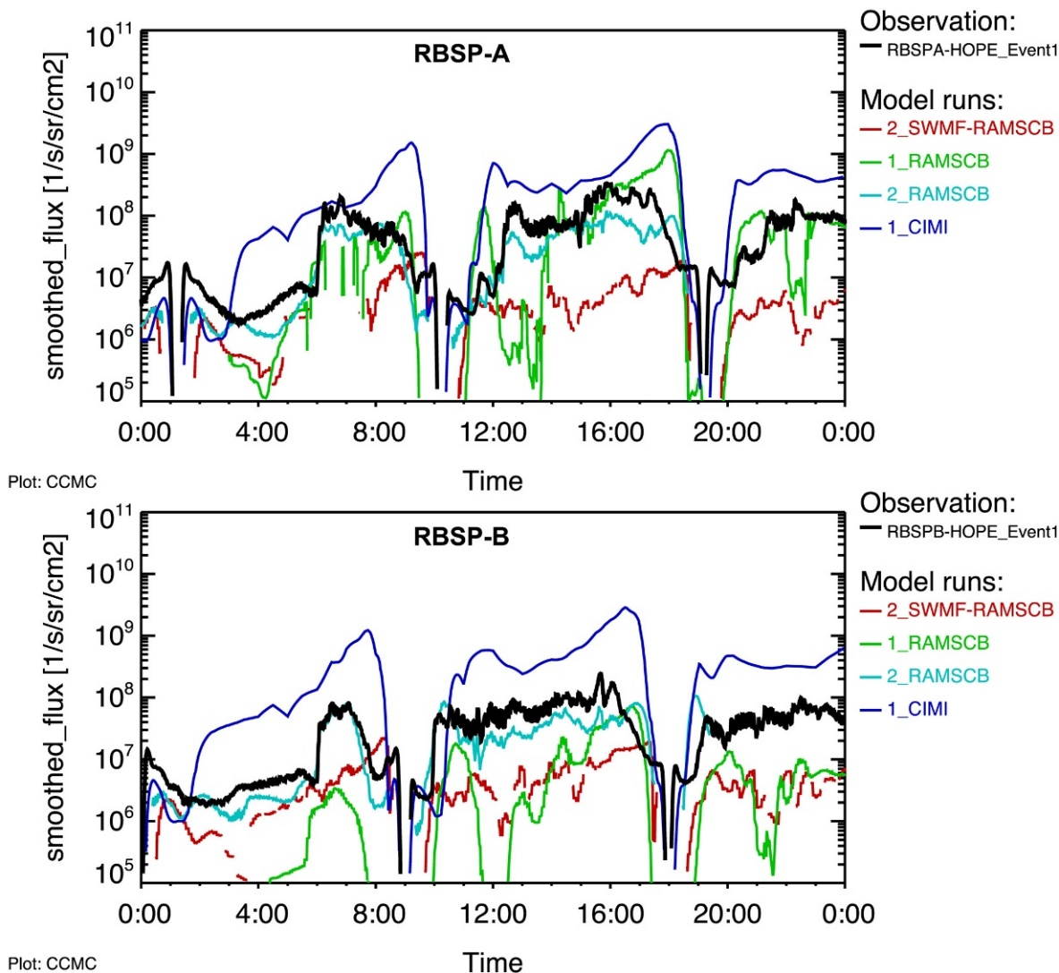
Looking ahead Improve our radiation belt modeling capabilities
Are discrepancies between data and models due to unrealistic model inputs/boundary conditions or missing physics?
We lack a good understanding of how the various wave activity that is critical to radiation belt variability is distributed for individual events
Our best estimates thus far are statistical. This is a major barrier for better predictability in events
The large variance of wave power is not captured in statistical wave models (Watt+ [2017])
Combine advective radial transport (e.g., March 1991) and diffusive processes
Understand the relative importance of diffusive and non-diffusive transport
Develop K2 type models (i.e., SDE in M-K, advective in L-MLT)
This will help improve understanding into the shock transport of electrons
Couple radiation belt models with various geospace simulation modules to cover a broad range of plasma populations in space
Lower energy boundary (seed population) at the outer boundary
Move the outer boundary to a larger radial distance (e.g., 10 Re)
Explore and evaluate other modeling approaches
Radiation belt reanalysis. Long term (e.g., 30 year) simulations
Machine learning, neural networks/deep learning, and big data techniques
Develop more probabilistic forecasting models
Incorporate nonlinear effects into large-scale radiation belt modeling
e.g., the numerical Green's function method (nonlinear dynamics directly)
Nonlinear calculations that include the effect of oblique propagation
Yu+ [2019]

Slide 40
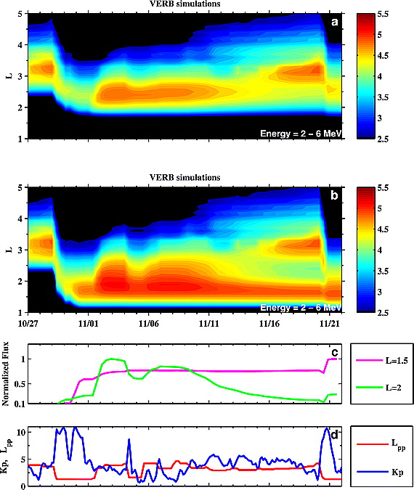
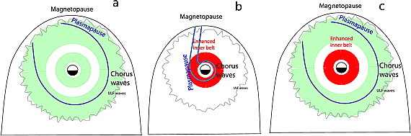
Looking ahead Extreme radiation belt environments/space weather
We need a better understanding of the processes that are relevant for extreme radiation belt environments
What is an extreme radiation belt environment?
What is the highest energy electrons can be accelerated to? What controls that?
What is the highest flux can be obtained in the radiation belts?
Shprits+ [2011]

Slide 41
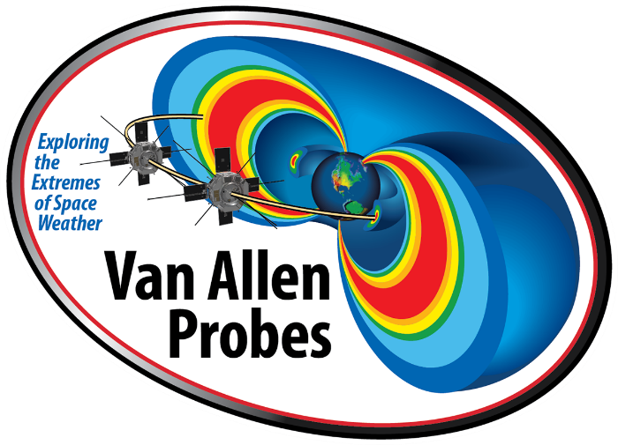

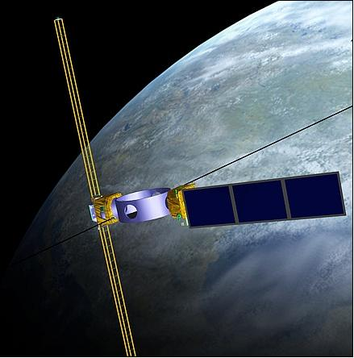
Looking ahead Radiation belt observations, post-Van Allen Probes
Arase/ERG | On orbit
DSX | 2019 Jun?
THEMIS | On orbit
MMS | On orbit
ICON | >2019 Spring
GDC | ~2025
SMILE | ~2023
GOES | On orbit
POES | On orbit
REACH | On orbit
LANL GEO | On orbit
GPS | On orbit
Cubesats | e.g., AC6, FIREBIRD
Balloons | e.g., BARREL
Sounding rockets | e.g., LAMP
Radiation belt
Inner magnetosphere
MI coupling
Credit: NASA/JHU/APL
SW/M coupling
Operational
Credit: JAXA
“Small”
Credit: AFRL/Sierra Nevada Corporation

Slide 42
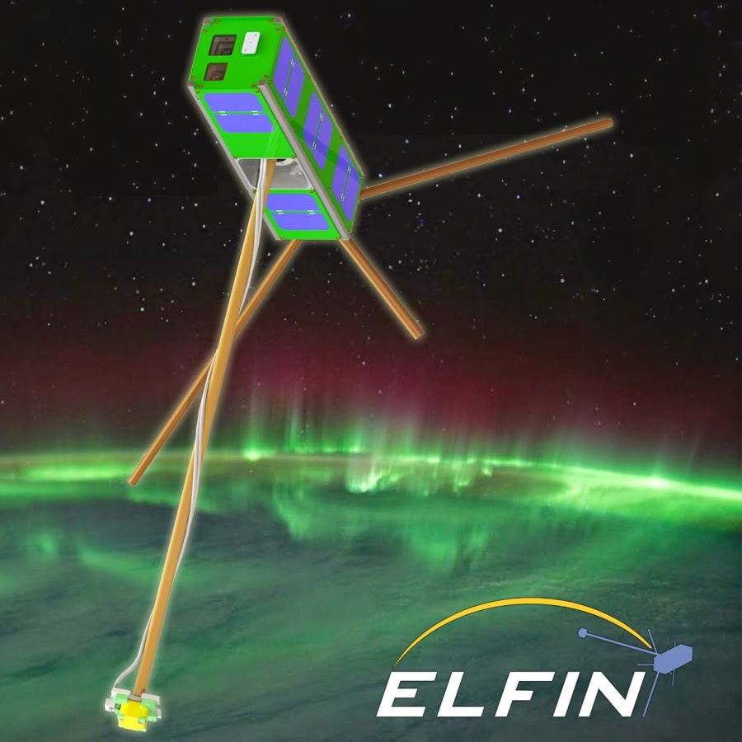
Looking ahead Radiation belt cubesats
ELFIN
On orbit
3U, LEO, has MAG
e⁻: 50 keV to 4.5 MeV
p⁺: ~50 keV to 300 keV
CeREs
On orbit
3U, LEO, no MAG
e⁻: ~5 keV to ~8 MeV
p⁺: ~200 keV to ~100 MeV
GTOSat
Launch ~early 2021
6U, GTO, has MAG
e⁻: 200 keV to 2 MeV
p⁺: 100 keV to 8 MeV (TBD)
REAL
Launch ~late 2021
3U, LEO, no MAG
e⁻: 0.1 keV to 2 MeV
p⁺: 5 MeV to 30 MeV
CIRBE
Launch ~2022
3U, LEO, no MAG
e⁻: 300 keV to 3 MeV
p⁺: 6.5 MeV to 30 MeV
Credit: UCLA

Slide 43
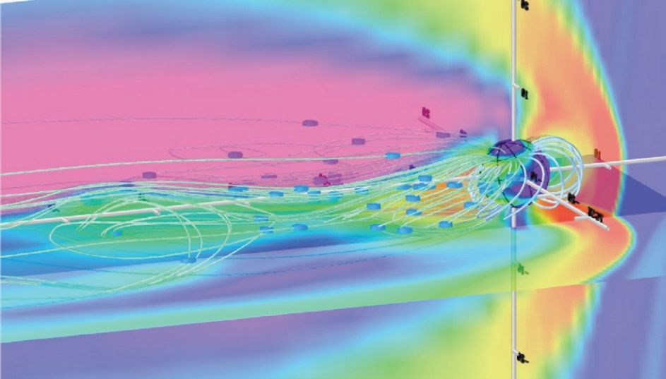
Looking ahead New missions and instrumentation
A high-altitude constellation mission to properly measure D_{LL} and PSD peaks beyond GEO
A low-altitude constellation mission (a high-LEO, ~1000-1200 km) to assess EPP impacts and linked/coupled processes in MLT
A mid-tail constellation mission to monitor the transition region and the seed/source population (~6-20 Re)
Invest in more inexpensive options for continued radiation belt monitoring
GTOSat is a good pathfinder for this
Encourage other countries to make (relatively) inexpensive measurements, e.g., multi-platform measurements like BARREL
Investigate what/how ground-based measurements can contribute to enhance MLT coverage; requires a better understanding of the impact of the ionosphere as a big filter
Identify the replacement for POES/MetOP precipitation measurements
Design an instrument that can prove experimentally Doppler shifted cyclotron resonance. What would be required? Is this possible with existing sensor technology?
CREDIT: NASA Science and Technology Definition Team, 2004, Global Dynamics of the Structured Magnetotail: Updated Synopsis of the Report of the NASA Science and Technology Definition Team for the Magnetospheric Constellation Mission, http://www.phy6.org/MagCON.pdf.

Slide 44
Thank you
Contributors
Jay Albert, Sasha Drozdov, Richard Horne, Mary Hudson, Allison Jaynes, Xinlin Li, Yoshi Miyoshi, Binbin Ni, Paul O'Brien, Yoshi Omura, Craig Rodger, Jean-Francois Ripoll, Weichao Tu, Drew Turner

